Slide 1
LAW ENFORCEMENT
RELIGIOUS FREEDOM

Slide 2
Outline
What is religious freedom
Religious Freedom Act
Establishment Clause
Free Exercise Clause
Example of Religious Freedom Act
“Protected Class” meaning
“Protected Class” in private sector
Hobby Lobby Group
LBGTQ Movement

Slide 3
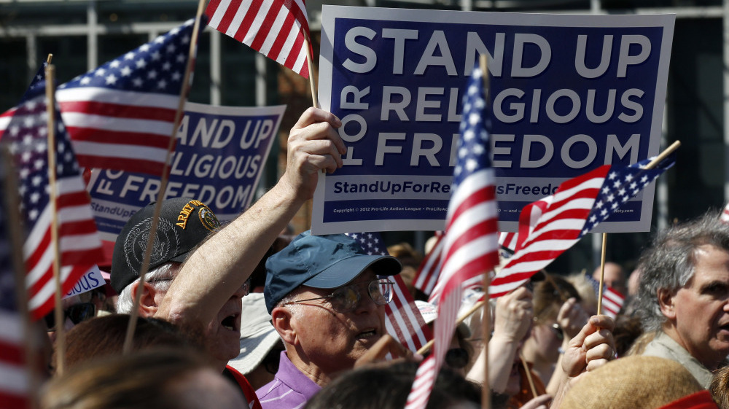
What is Religious Freedom?
Notes:
Freedom of religion is a fundamental principle that supports the right for an individual or community both in the public and private sector to choose a religion, worship and follow their own beliefs and practices in the religious circle (Laycock, 1994). Also envisioned in this principle is the freedom for one to change his/her own religion. Many people across the globe consider freedom of religion to be a fundamental human right. In any country with a state religion, freedom of religion implies that the government allows other sects to embrace their own religious practices besides that which is practiced by the state in general. The government therefore does not persecute believers who embrace other religious practices. Therefore, nations with a state religion have the freedom of religion envisioned in their constitutions in order to protect the rights of people in the religious circle.

Slide 4
Explain the Religious Freedom Act
Religious Freedom Restoration Act of 1993
Envisioned in the bill of rights-1st Amendment
Establishment clause
Free Exercise Clause
Notes:
The Religious Freedom Act set forth the rights of Americans to practice one’s religious practices. All this stems from the Bill of Rights which protects many freedoms that Americans embrace today. United States Constitution, 1st amendment has it that “Congress shall make no law respecting an establishment of religion, or prohibiting the free exercise thereof”. Therefore, religious freedom is envisioned in the establishment clause and the free exercise clause of the First Amendment (Laycock, 1994).

Slide 5
Establishment Clause
Property of religious sects free from taxation
Public officials take oath in God’s name
Session in state agencies open with prayer
Nation anthem and currency refer to God
Notes:
The establishment clause has it that the government will not chose an official religion it will support. This clause not only forbids the government from establishing an official religion but also prohibits government actions that unduly favor one religion over another (Laycock, 1994). This law also prohibits the government from unduly preferring religion over non-religion, or non-religion over religion. The United States government has committed to encouraging churches and religion. For example, the government does not tax religious sects in the country. Also, national government functions in the public open with prayer from diverse religious sects. Therefore, the government is bound to embrace all religions with the aim of instilling religion freedom within its borders.

Slide 6
Free Exercise Clause
Guarantees right to practice religion
Does not:
Violate criminal laws
Offend public moral
Threaten safety of the community
Notes:
The free exercise clause guarantees each person the right to believe and practice their religion as they wish so long as their religious practices do not violate criminal laws, offend public morals or otherwise threaten the safety of the community. Also, this is applicable so long as such laws were not created to target a specific religious sect (Laycock, 1994). The issue that arises pertains to the extent at which the government can control conduct that is based on religious beliefs. Although the government may not specifically target the practices of a certain religion, the general restrictions on conduct which are directed at everyone may be applied to individuals engaging in that proscribed conduct for religious reasons.

Slide 7
Examples of Religious Freedom Act
Religious discrimination
Religious censorship
Notes:
An example of this act is religious discrimination. It is clear that many people are discriminated in society due to their religious beliefs. This is because they practice a different religion from that practiced by the majority population (Laycock, 1994). Religious discrimination relates to the subject of contraception and LBGTQ movement in that the people affiliated to this group are discriminated in many sectors of society. Also, the people affiliated to the LBGTQ movement align with what is morally accepted in the teachings of religion. Different religions teach different things about sexual orientation. And therefore it is important for people to practice what their religion embrace. The state is also responsible of embracing what different religious groups practice in society.

Slide 8
Explain What “Protected Class” Means
Explain first what “protected class” means in terms of the public and private sector.
Legally protected people
Prevents discrimination
Protected class include: race, color, religion, national origin, sex, disability, and familial status)
Notes:
“A protected class” is a group of individuals who share a common trait and therefore are legally protected from discrimination based on that trait. The Civil Rights Act of 1964 and other laws enforced over the years prohibited discrimination against an individual or groups of people based on particular traits (Ellison, 2017). This is mainly practiced in both the public and private domain. Therefore, the law is clear on the protection of such individuals. It means that those who discriminate or harass individuals based on their traits have a case to answer in the court of law.

Slide 9
“Protected Class” in Private Sector
Whether this standard must be applied to the private sector.
Notes:
While not required by federal law, the private sector has instilled policies aimed at protecting their employees from discrimination or harassment based on their traits. Therefore, employers have the responsibility of ensuring that employees are protected from discrimination and harassment based on their individual traits. The United States Equal Employment Opportunity Commission (EEOC) enforces many federal laws aimed at prohibiting employment discrimination (Kovacs, 2017). The laws protect employees and job applicants against employment discrimination when it involves unfair treatment because of race, color, religion, sex, national origin, and age. Therefore, the standard of “protected classes” applies in the private sector because it seeks to protect individuals from discrimination and harassment based on their traits.

Slide 10
Contraception (Hobby Lobby) Group
Are those affiliated with this movement considered a “protected class” as set forth by the United States Supreme Court?
Does not belong to “protected class”
Women denied right to insurance coverage for birth control
Notes:
The Burwell v. Hobby Lobby case addressed the intersection of the Restoring Religious Freedom Act and the Affordable Care Act’s contraceptive mandate, which requires employers to provide their employees with health insurance coverage for contraception. The court ruled that the mandate could not be applied to closely held for-profit corporations with religious objections to certain types of contraception (Ellison, 2017). In stead, the government would make up for the difference. Since then, the issue has raised debates in courts. Therefore, it means that the Hobby Lobby group does not belong to the “protected class”. This is because the government prohibits certain employers from providing insurance coverage for birth control if they conflict with the employer’s religious beliefs. The ruling was a blow to the rights of women with conflicting religious beliefs to those of their employers’.

Slide 11
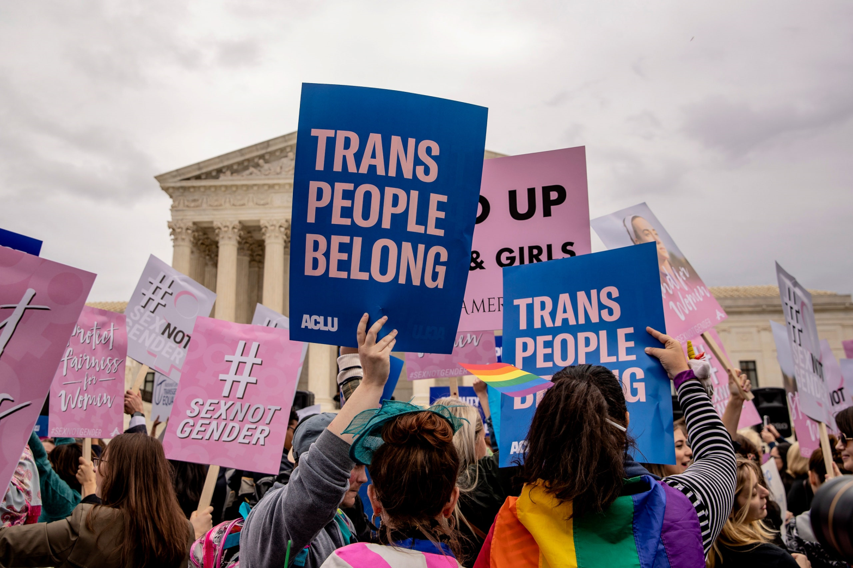
LBGQT Movement
Notes:
The people affiliated to the LBGQT movement are considered a “protected class”. LBGTQ movement has come into the mainstream in recent years thanks to the efforts of people oriented to the movement championing for their rights (Kazyak, 2018). The main concern of LBGTQ people is that they are discriminated and harassed in society. And this is why recent rulings in the Supreme Court have aimed at protecting the rights of these people. Just recently in Donald Trump’s administration, the Supreme Court in a landmark decision ruled that Title VII of the Civil Rights Act of 1964 prohibits workplace discrimination against gay, lesbian and transgender people. This solidified the view that LBGQT people ate a “protected class” in both the public and private domain.

Slide 12
References
Laycock, D., & Thomas, O. S. (1994). Interpreting the Religious Freedom Restoration Act. Tex. L. Rev., 73, 209.
Kazyak, E., Burke, K., & Stange, M. (2018). Logics of freedom: Debating religious freedom laws and gay and lesbian rights. Socius, 4, 2378023118760413.
Ellison, M. M. (2017). Civil marriage, same-sex couples, and religious freedom: reflections from a US scholar-activist. Theology & Sexuality, 23(3), 249-254.
Kovacs, E. (2017). Religious Freedom, Religious Discrimination and the Workplace.

